Slide 1

Online Event Planner
– TEAM ELITE

Slide 2
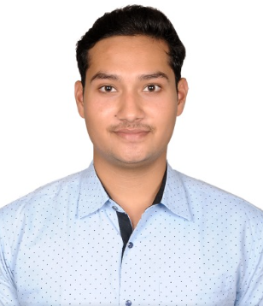
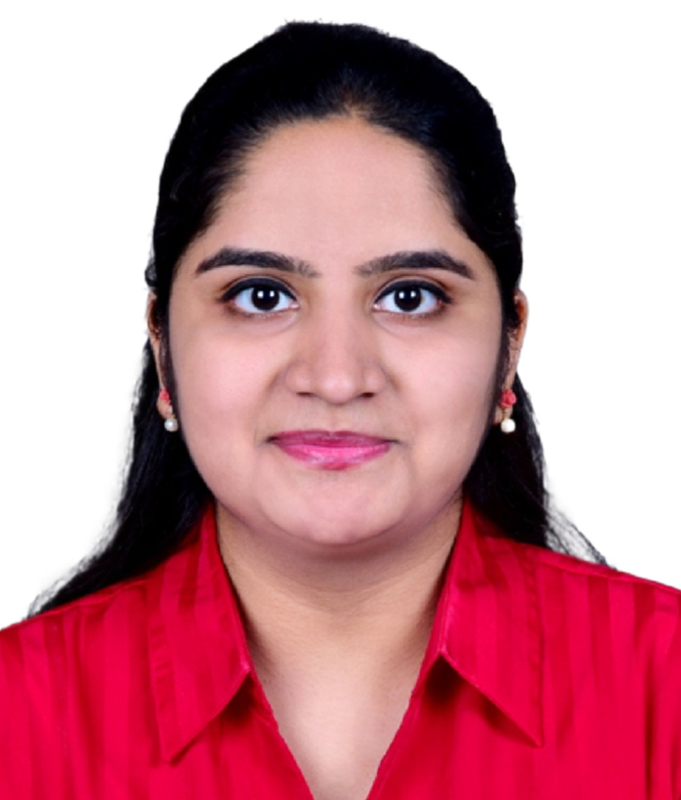
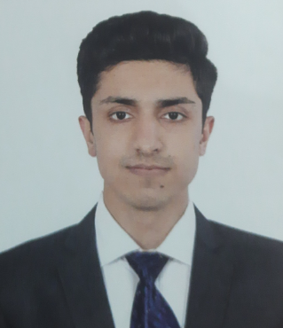
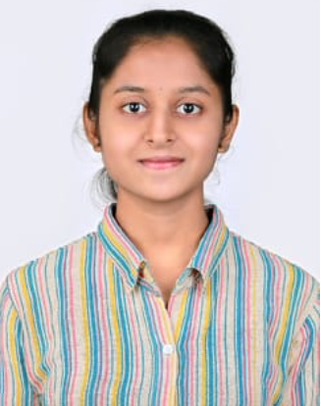

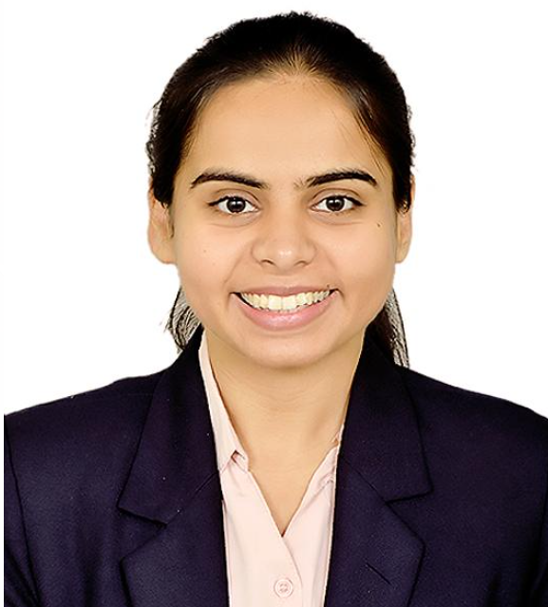

Meet the Developers…
Aniket Jain
Backend Developer
Silvia Pereira
Frontend Developer
Bhavesh Awal
Backend Developer
Sakshi Shimpi
Frontend Developer
K. Amogh Raman
Backend Developer
Sakshi Tejwani
Frontend Developer
Tanya Ramwani
Frontend Developer

Slide 3

We DESIGN your DREAMS…

Slide 4
A glimpse of MAKE IT HAPPEN…
An online event management system is a digital platform designed to streamline the planning and organization of various events, including birthdays and marriages. This system typically offers a range of features to help users manage every aspect of their events effectively. Here are some key features commonly found in such a system:
1. User Registration and Login : Users can create accounts and log in to the system. This allows them to save their event details, track progress, and access their event history.
2. Event Creation: Users can create new events by providing essential details such as event type (e.g., birthday, marriage), date, time, location, and a brief description.
3. Vendor Management: The system provides a database of vendors or service providers related to event planning, such as caterers, photographers, decorators, and entertainers. Users can browse vendor profiles, view ratings and reviews, and contact vendors for quotes and availability.

Slide 5
4.Budget Management: Users can set budgets for their events and track expenses. The system can generate expense reports and provide recommendations to help users stay within their budget.
5.Task and Checklist Management: Users can create to-do lists, set deadlines, and track tasks related to event planning. The system can send reminders for pending tasks.
6.Event Timeline: A visual timeline or calendar helps users keep track of all the important dates and deadlines related to their event.
7.Descriptive Webpages: Users and vendors have dedicated profile pages with detailed information, including contact details, portfolio (for vendors), and event history (for users).
An online event management system simplifies the entire event planning process by centralizing information, automating tasks, and providing access to a network of vendors and resources. Users can efficiently plan and organize their events, from small gatherings like birthdays to large-scale celebrations like weddings, all within a user-friendly digital platform.

Slide 6
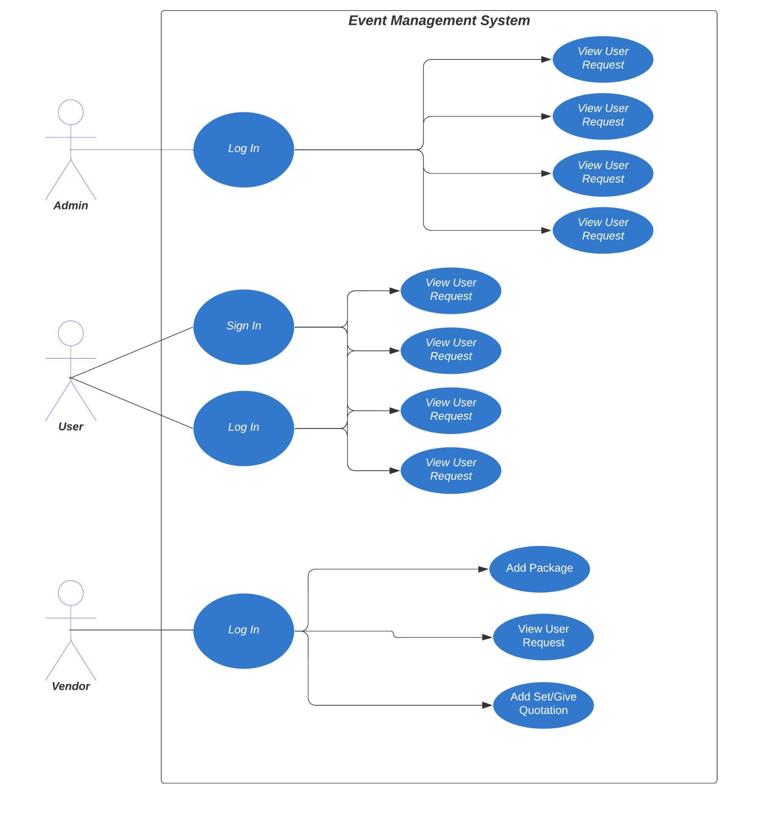
Use Case Diagram

Slide 7
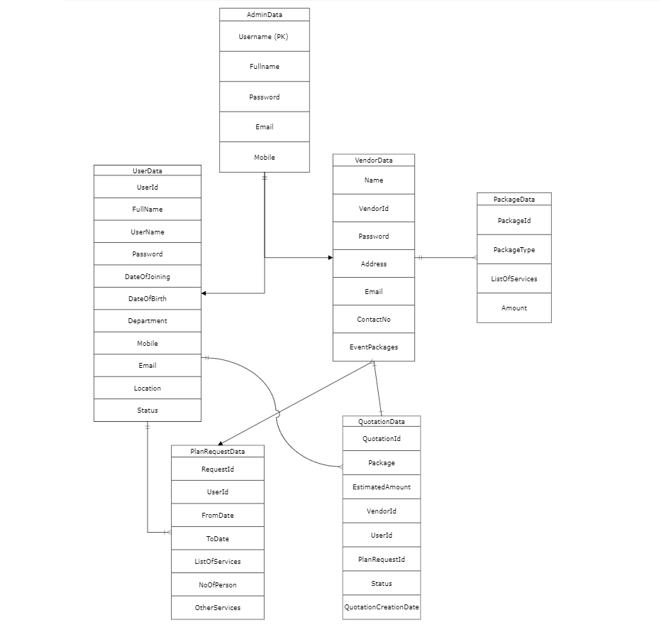
ER Diagram

Slide 8
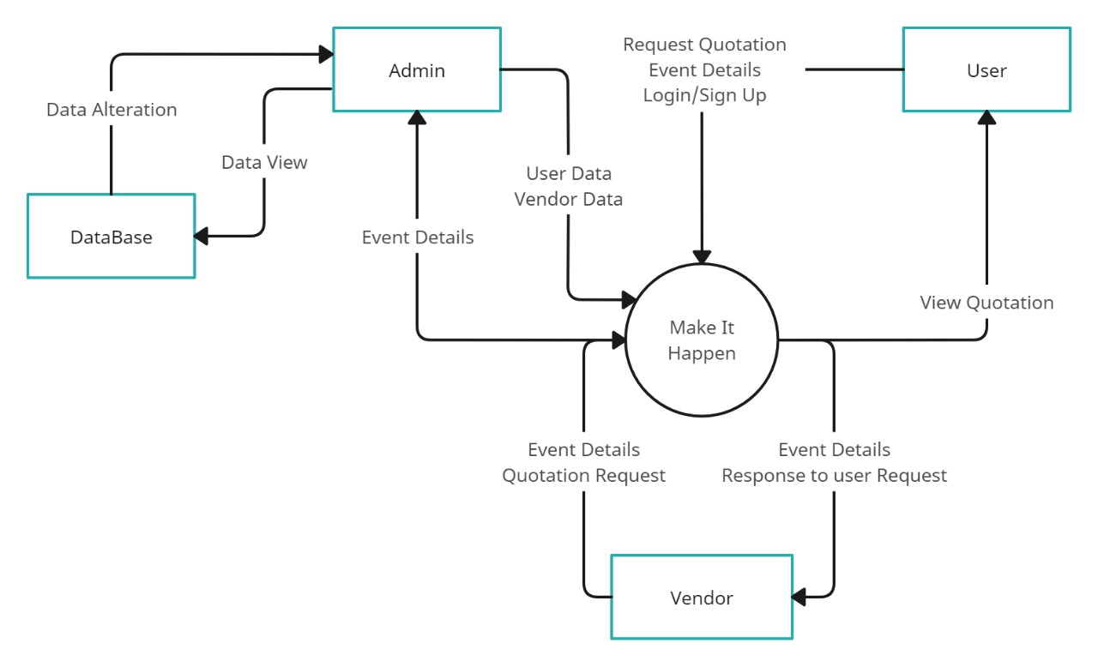
Data Flow Diagram

Slide 9
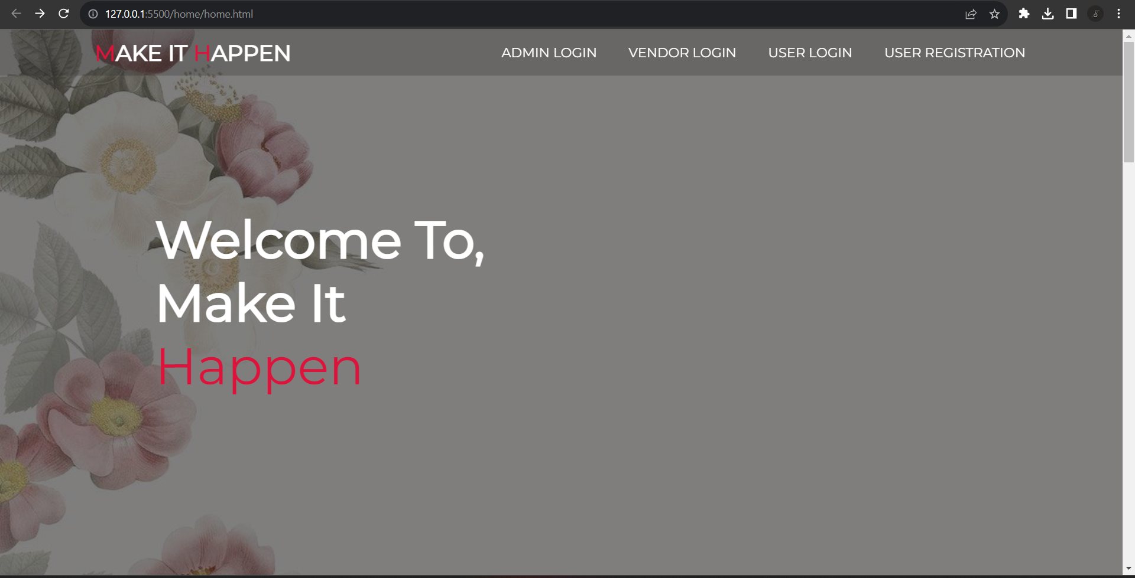
Website Workflow Insights
Welcome to ‘Make It Happen’ Homepage

Slide 10
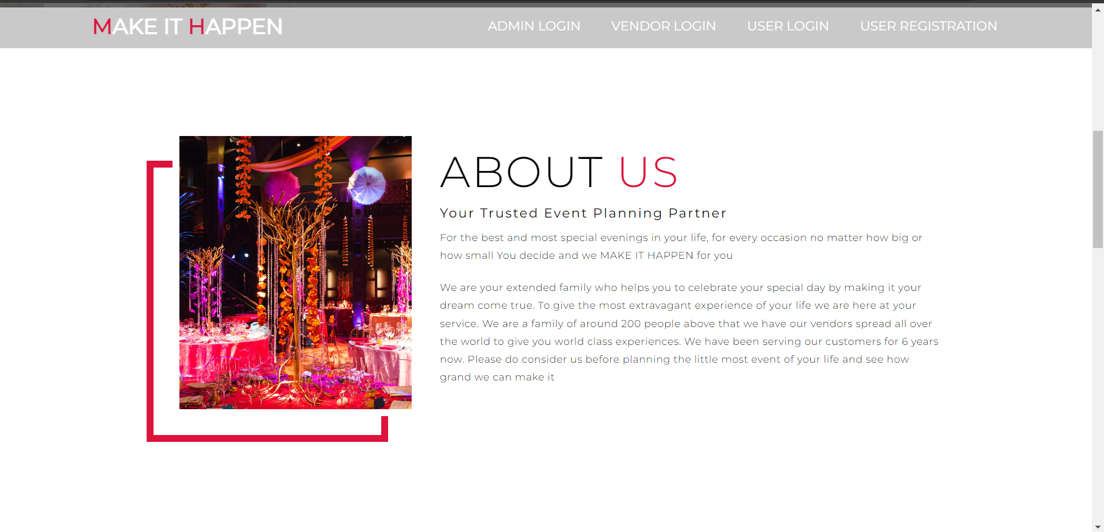
Welcome to ‘Make It Happen’ Homepage

Slide 11
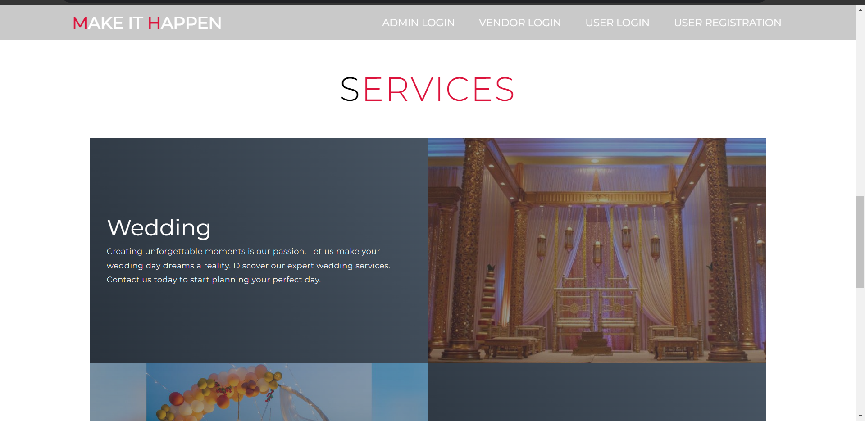
Welcome to ‘Make It Happen’ Homepage

Slide 12
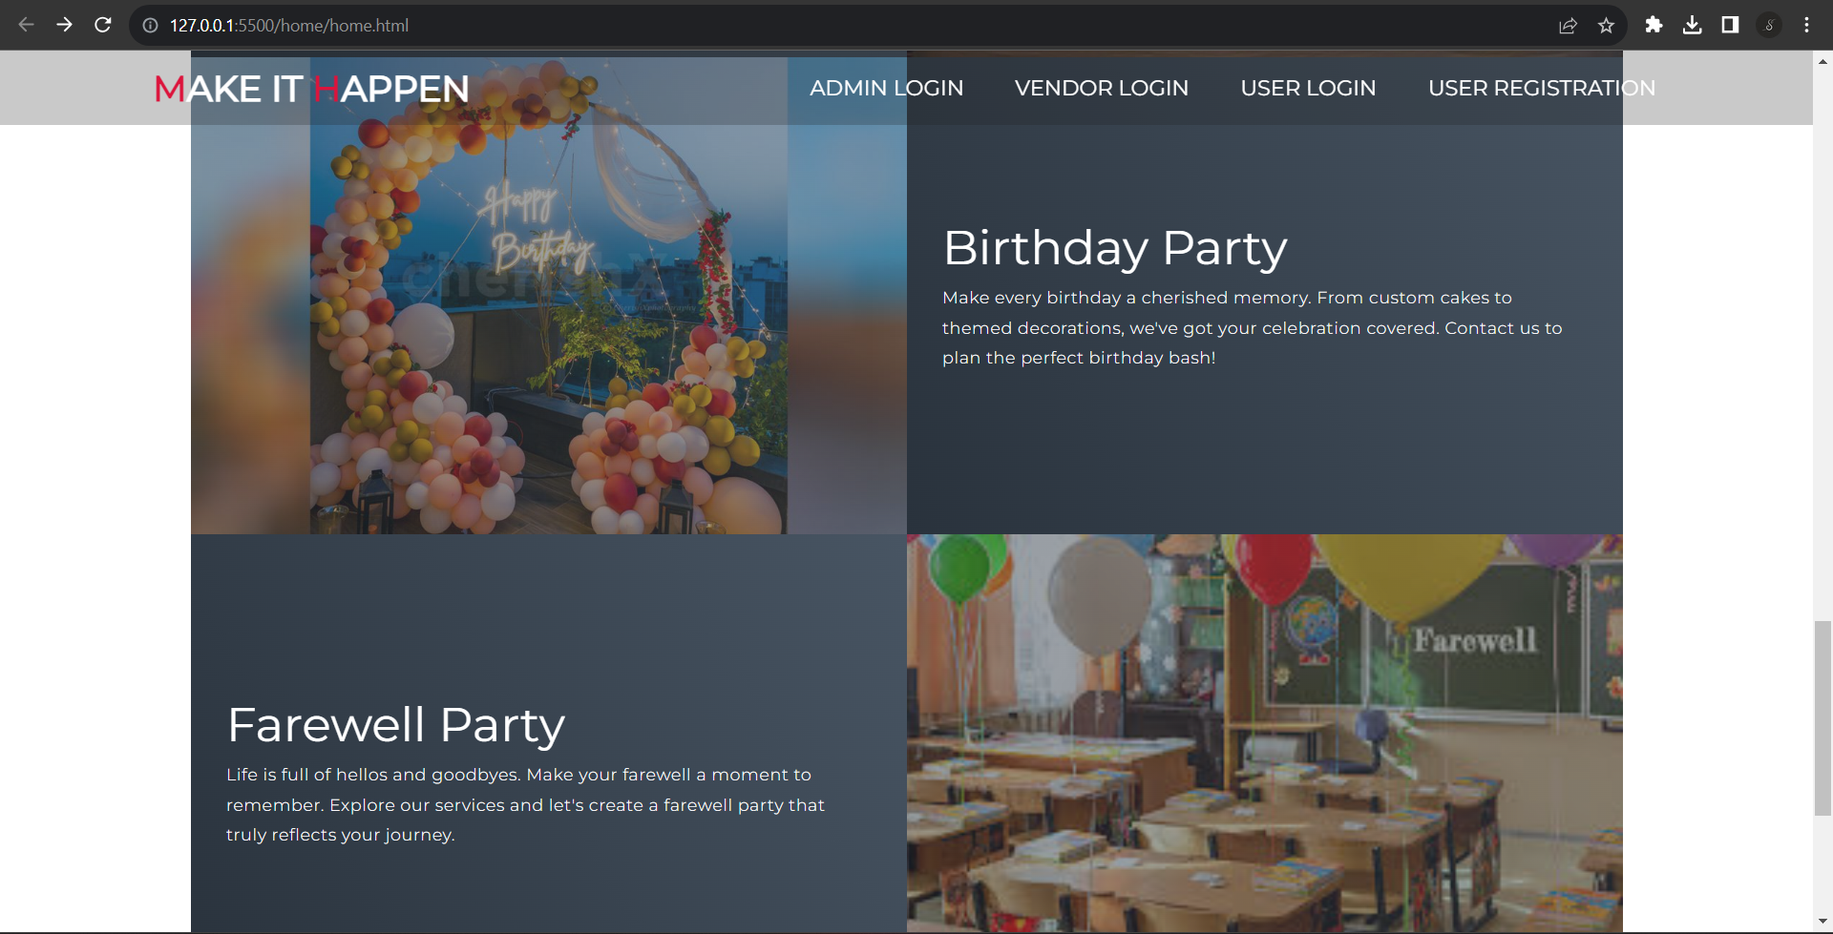
Welcome to ‘Make It Happen’ Homepage

Slide 13
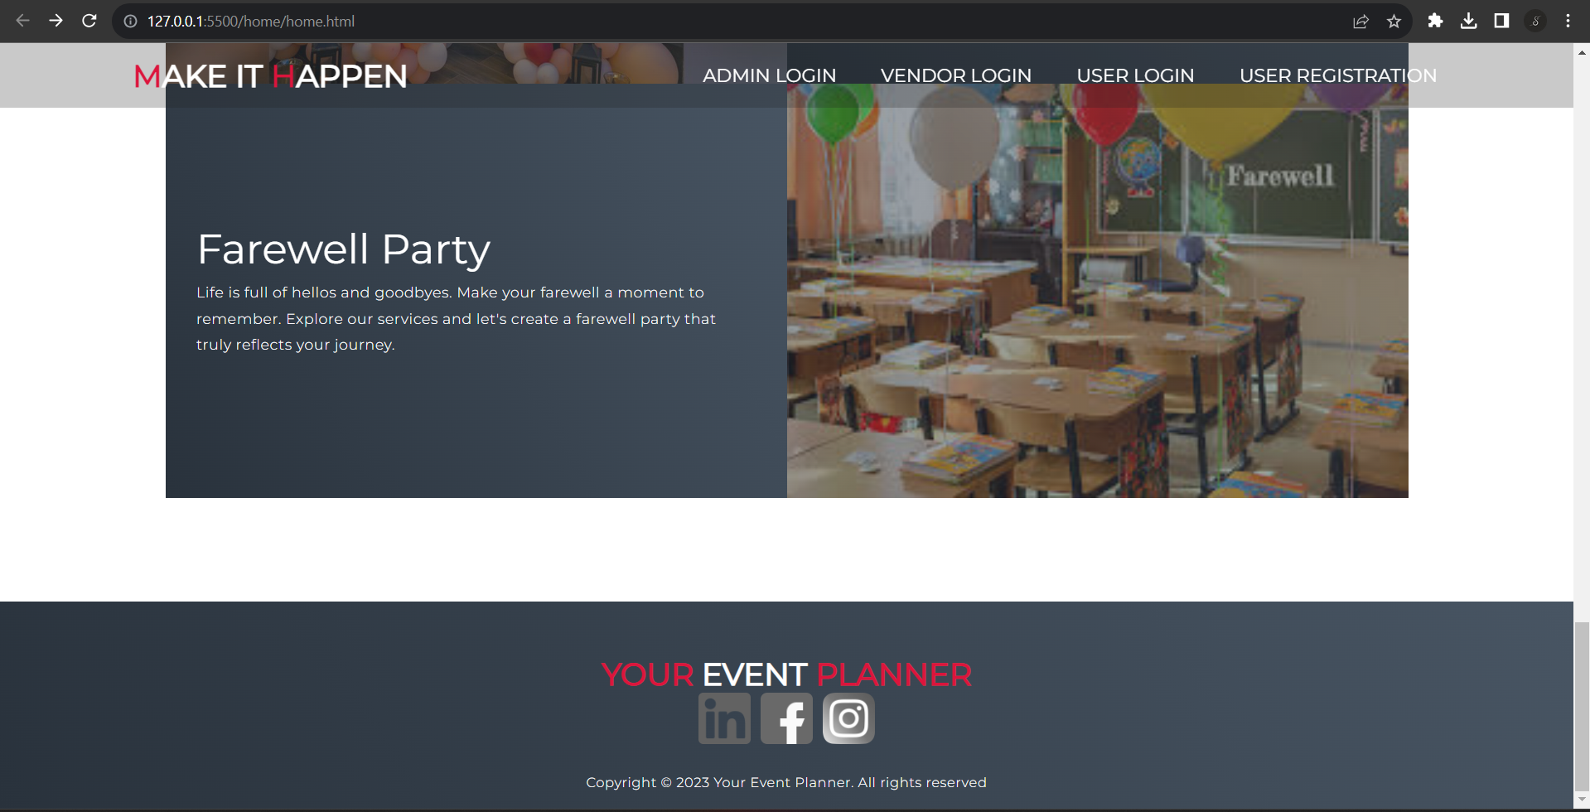
Welcome to ‘Make It Happen’ Homepage

Slide 14
Clicking on 'Admin Login' will redirect you to the admin login form page.

Slide 15
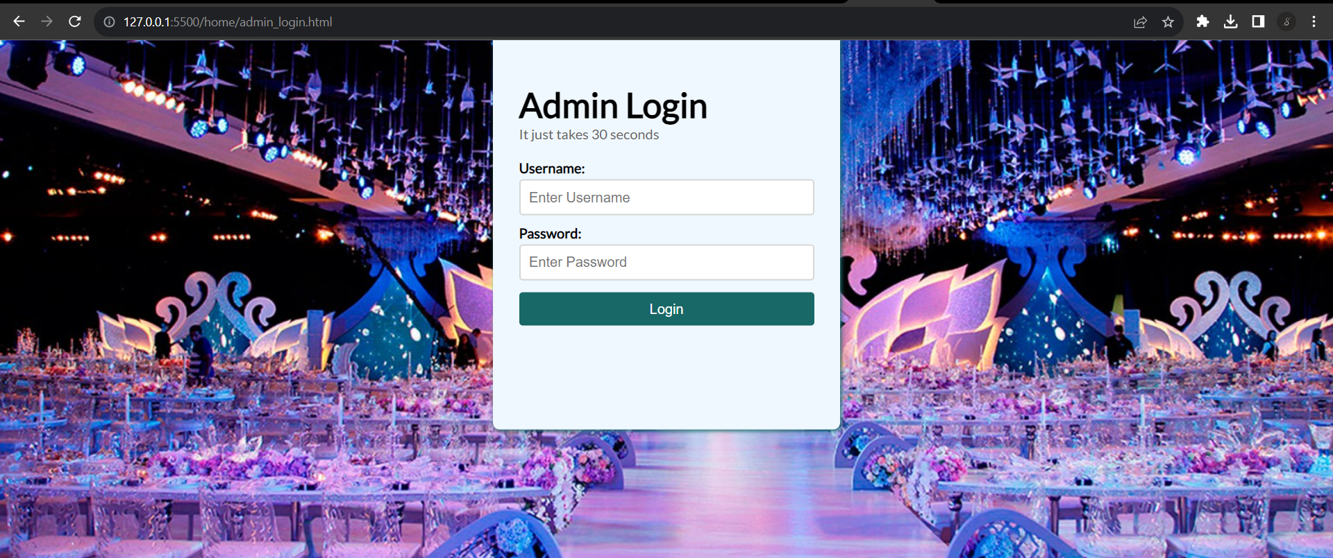
Clicking on 'Admin Login' will redirect you to the admin login form page.

Slide 16
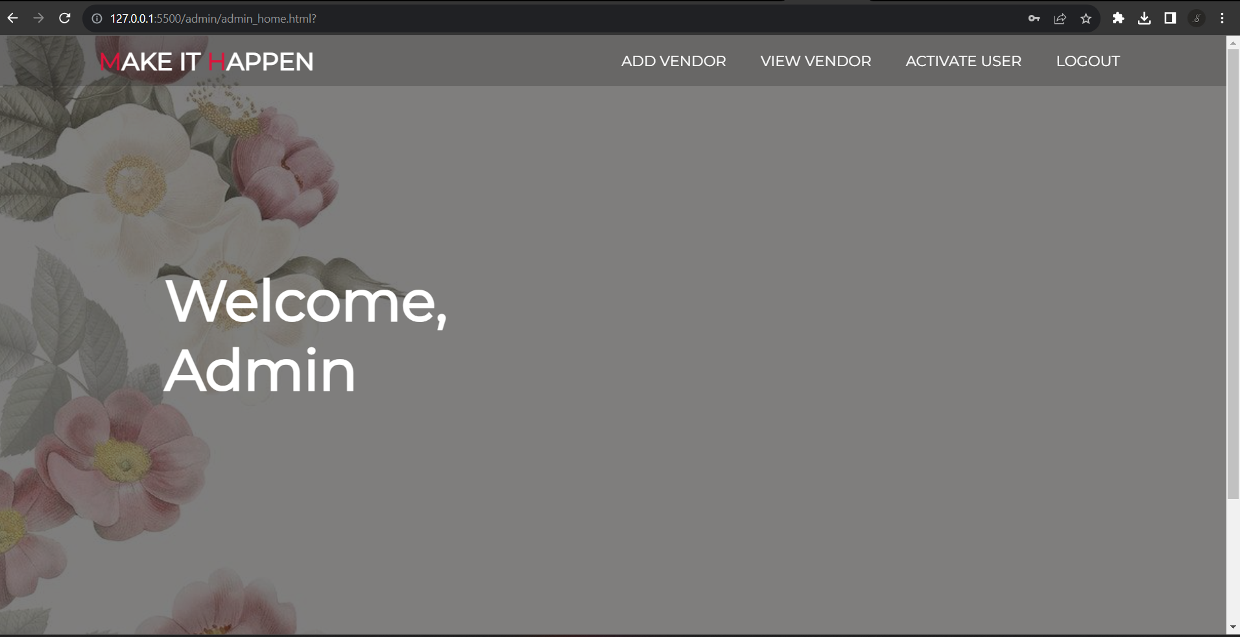
After a successful login, you will be redirected to the admin home page.
The page contains links to 'Add Vendor,' 'View Vendor,' and 'Activate User.

Slide 17
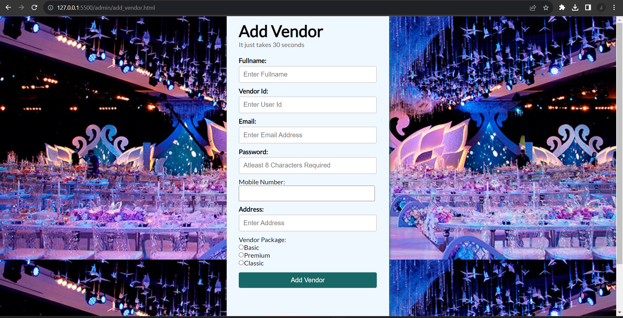
Clicking on 'Add Vendor' will redirect you to the add vendor form page.

Slide 18
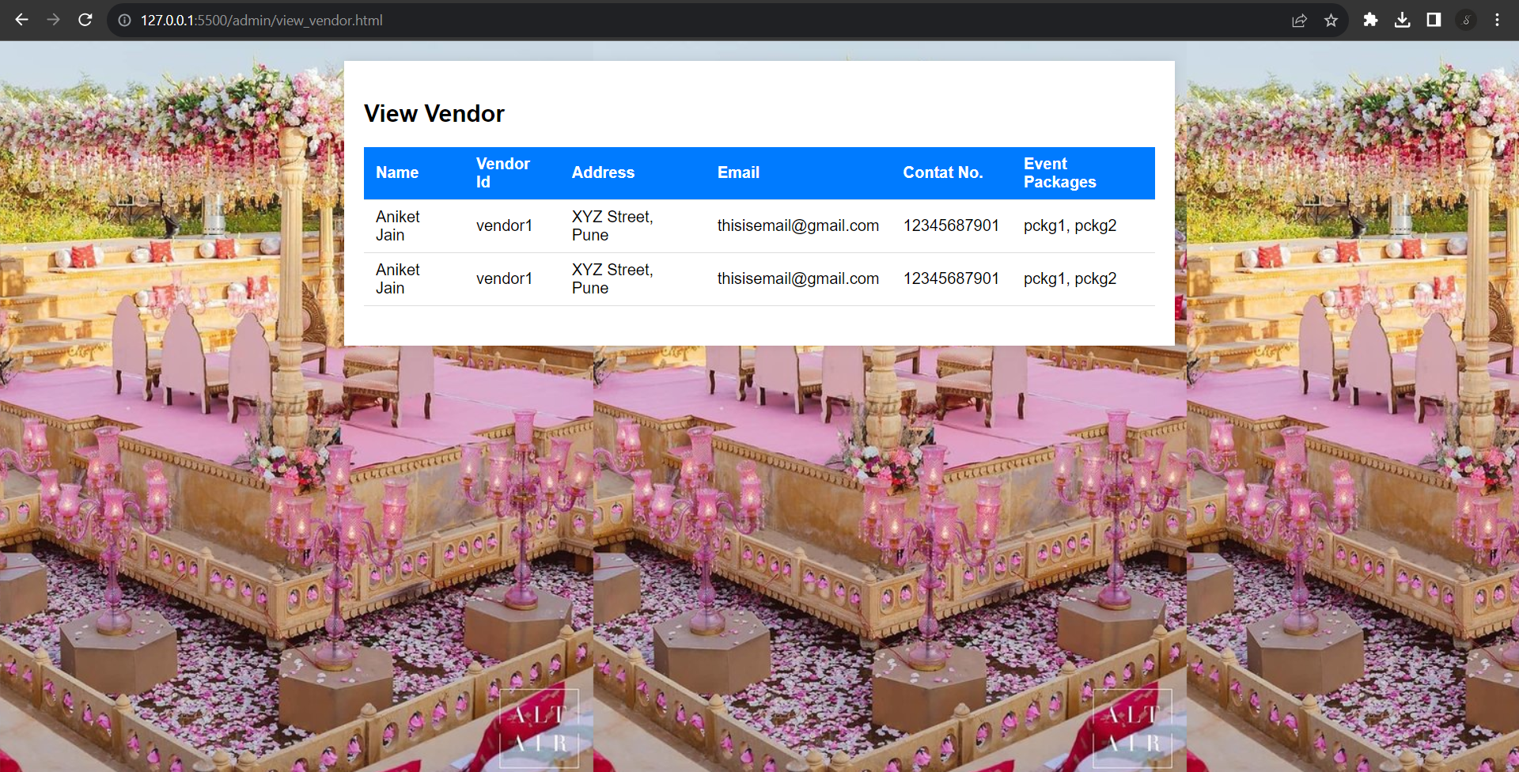
Clicking on 'View Vendor' will redirect you to the view vendor page.

Slide 19
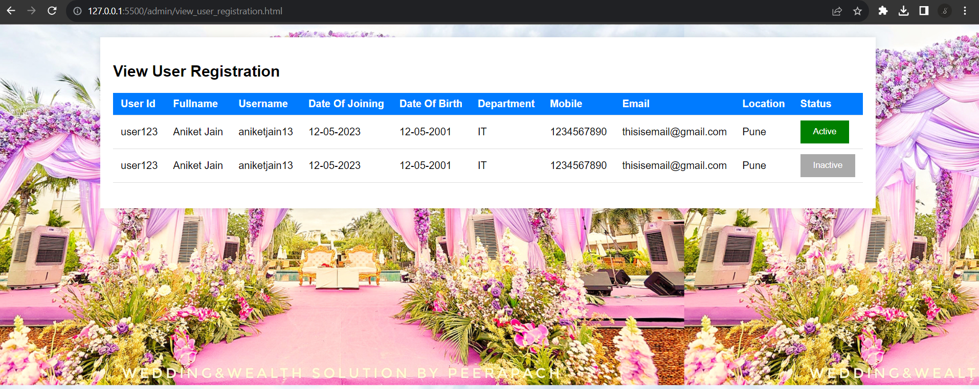
Clicking on 'View User Registration' will redirect you to this page.

Slide 20
Clicking on 'Vendor Login' will redirect you to the vendor login form page.

Slide 21
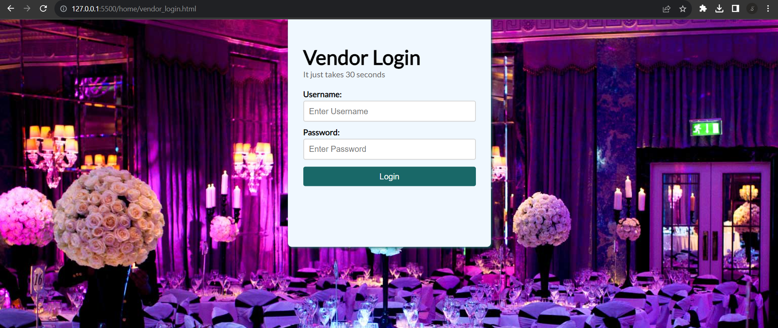
Clicking on 'Vendor Login' will redirect you to the vendor login form page.

Slide 22
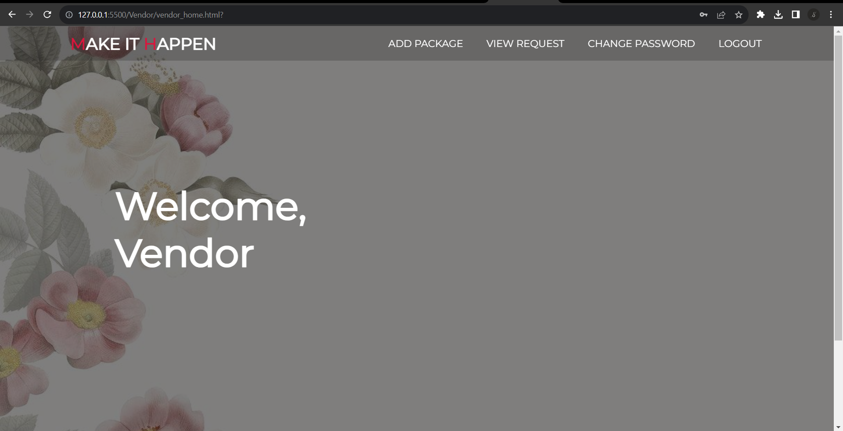
After a successful login, you will be redirected to the vendor home page.
The page contains links to 'Add Package,' 'View Request'

Slide 23
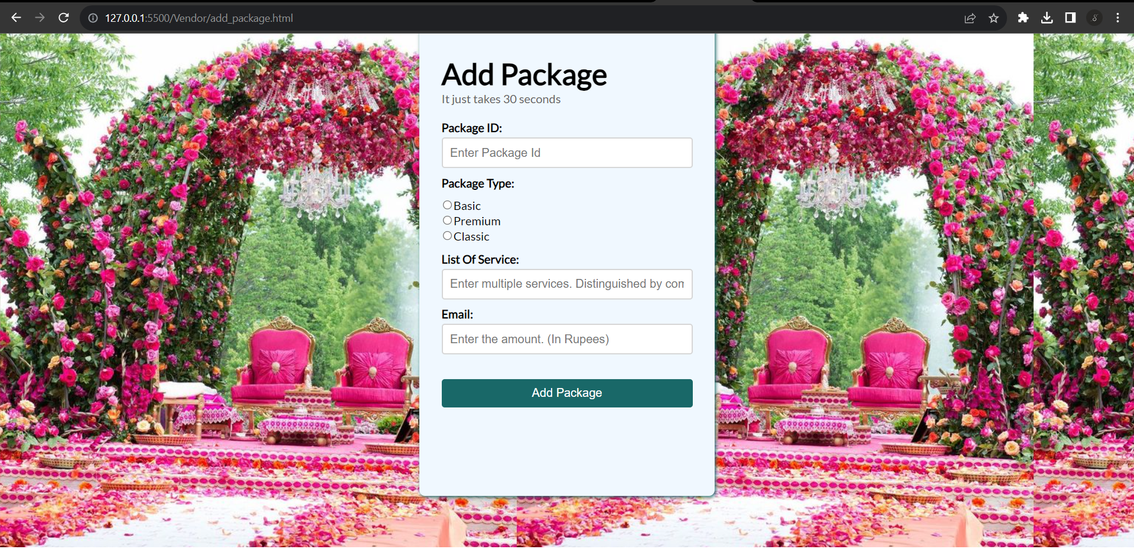
Clicking on 'Add Package' will redirect you to this page.

Slide 24
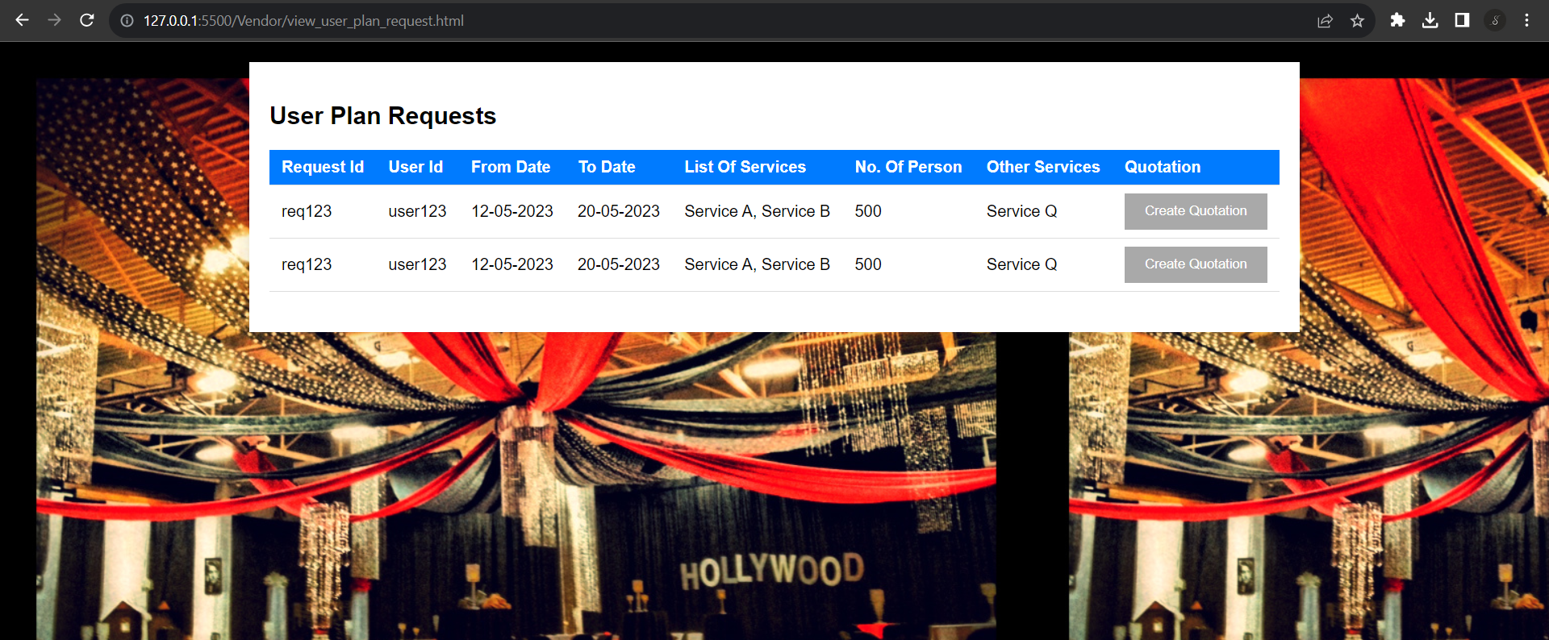
Clicking on 'User Plan Request' will redirect you to this page.

Slide 25
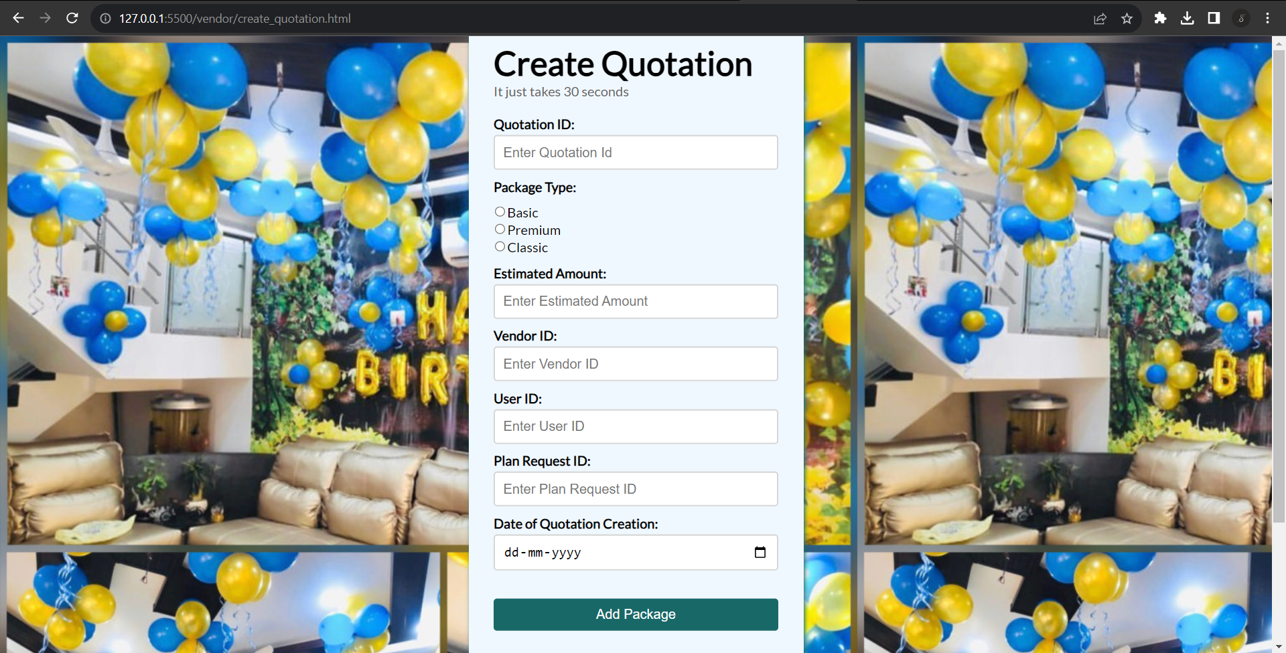
Clicking on 'Create Quotation' will redirect you to this page.

Slide 26
Clicking on 'User Login' will redirect you to the user login form page.

Slide 27
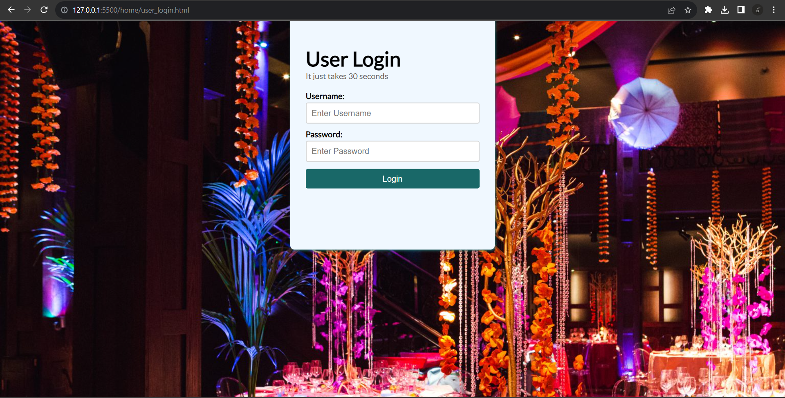
Clicking on 'User Login' will redirect you to the user login form page.

Slide 28
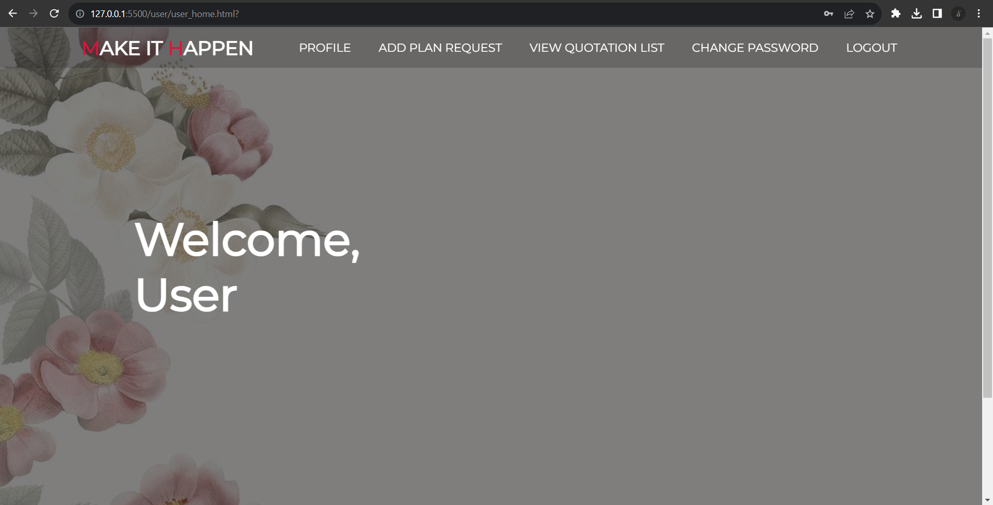
After a successful login, you will be redirected to the User home page.
The page contains links to 'View Profile', 'Add Plan Request' , 'View Quotation List' & Change Password

Slide 29
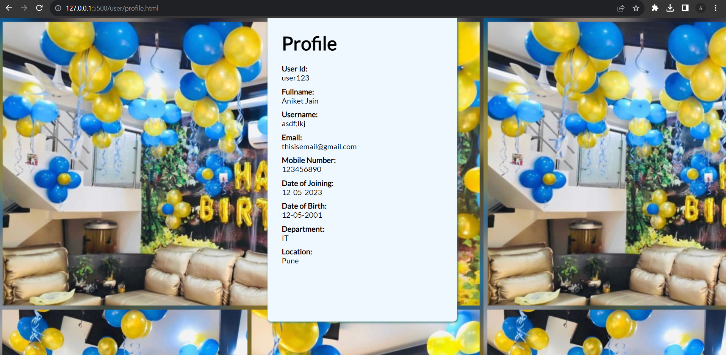
Clicking on 'View Profile' will display the user's profile.

Slide 30
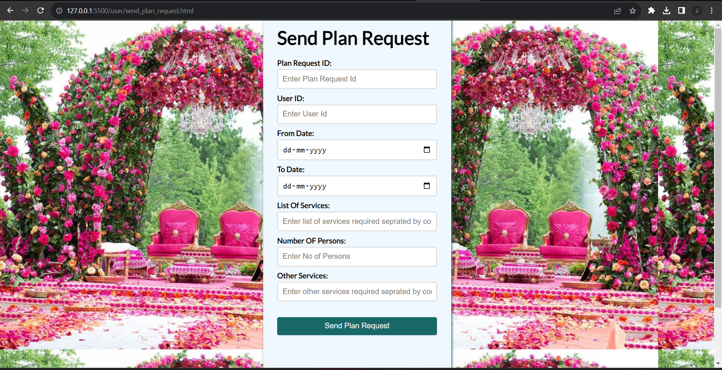
Clicking on 'Send Plan Request' will redirect you to this form page.

Slide 31
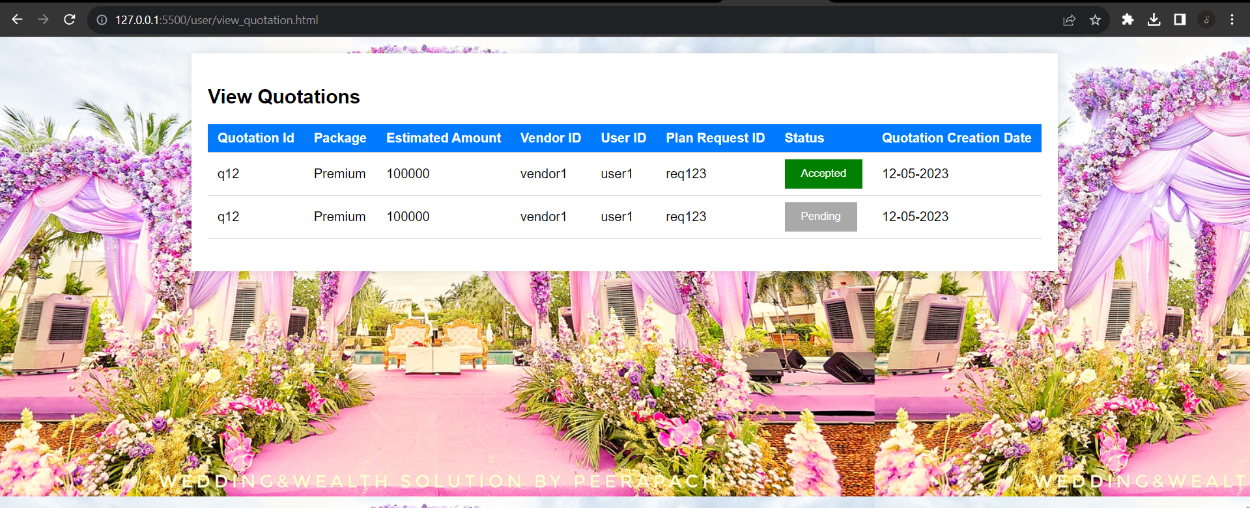
Clicking on 'View Quotations' will redirect you to this page.

Slide 32
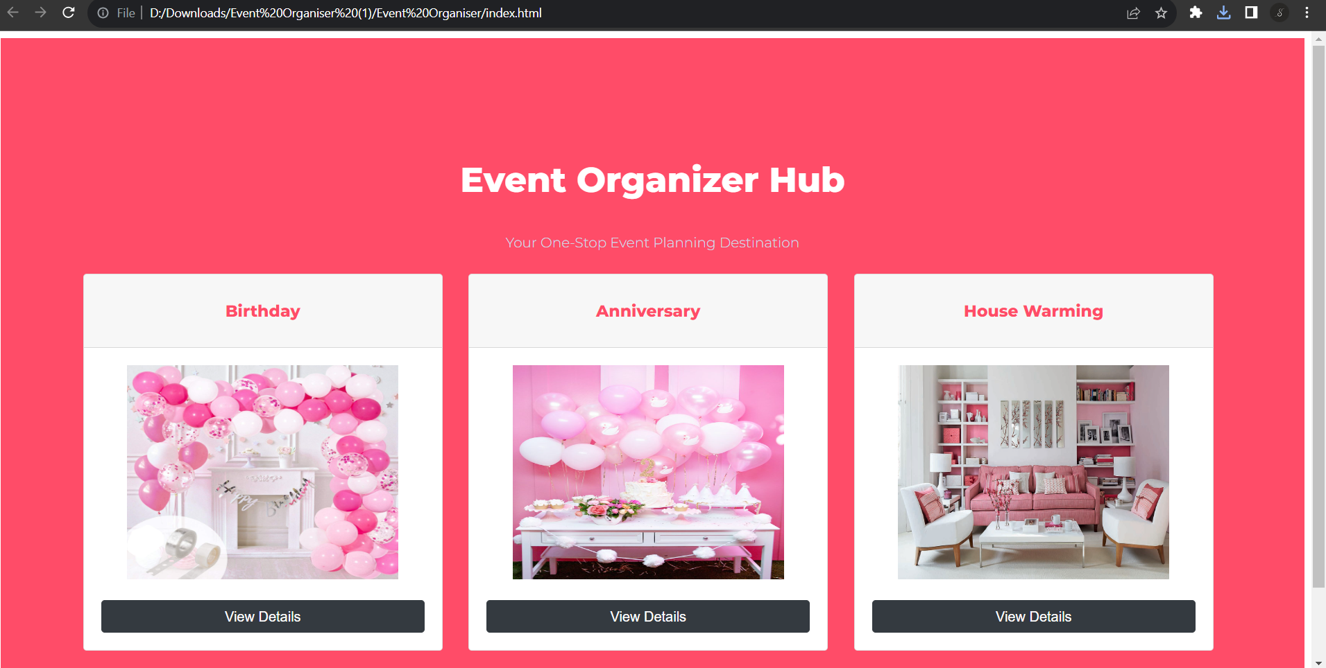
Clicking on 'View Quotations' will redirect you to this page.

Slide 33
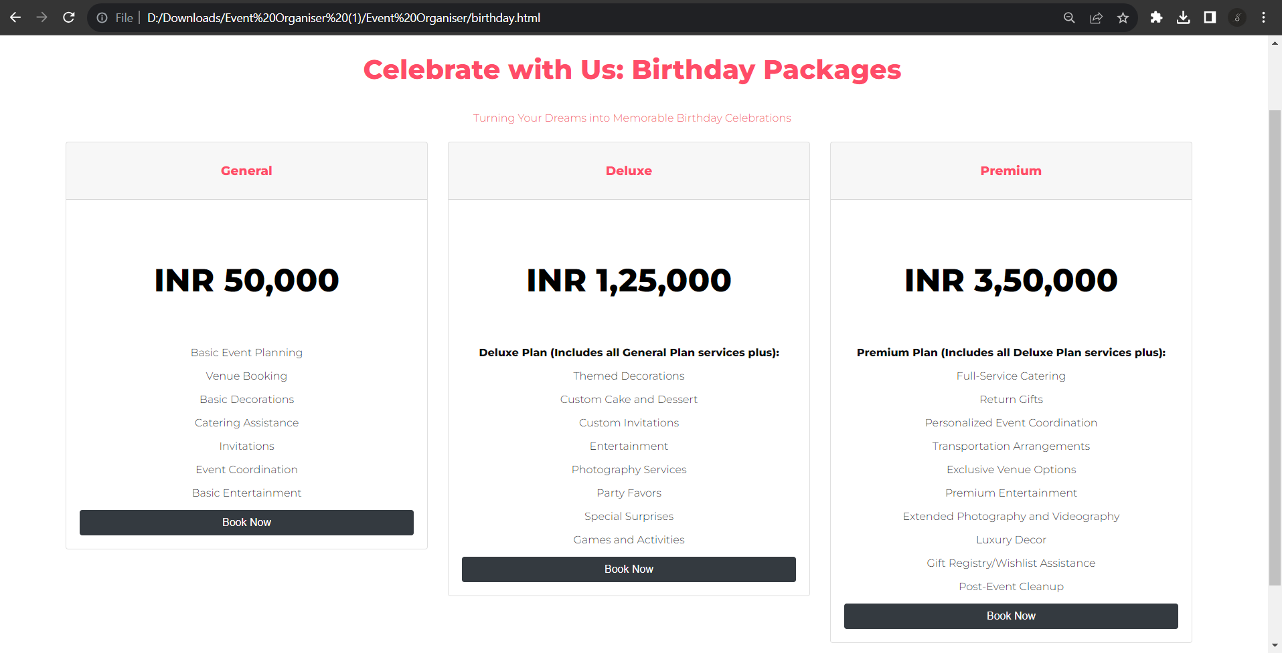
Quotation for Birthday party

Slide 34
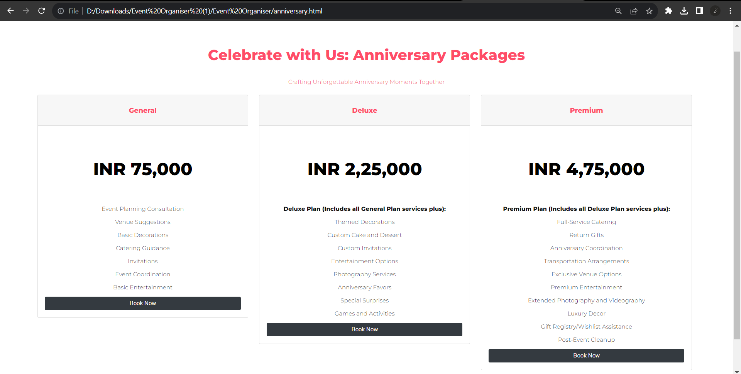
Quotation for Anniversary celebration

Slide 35
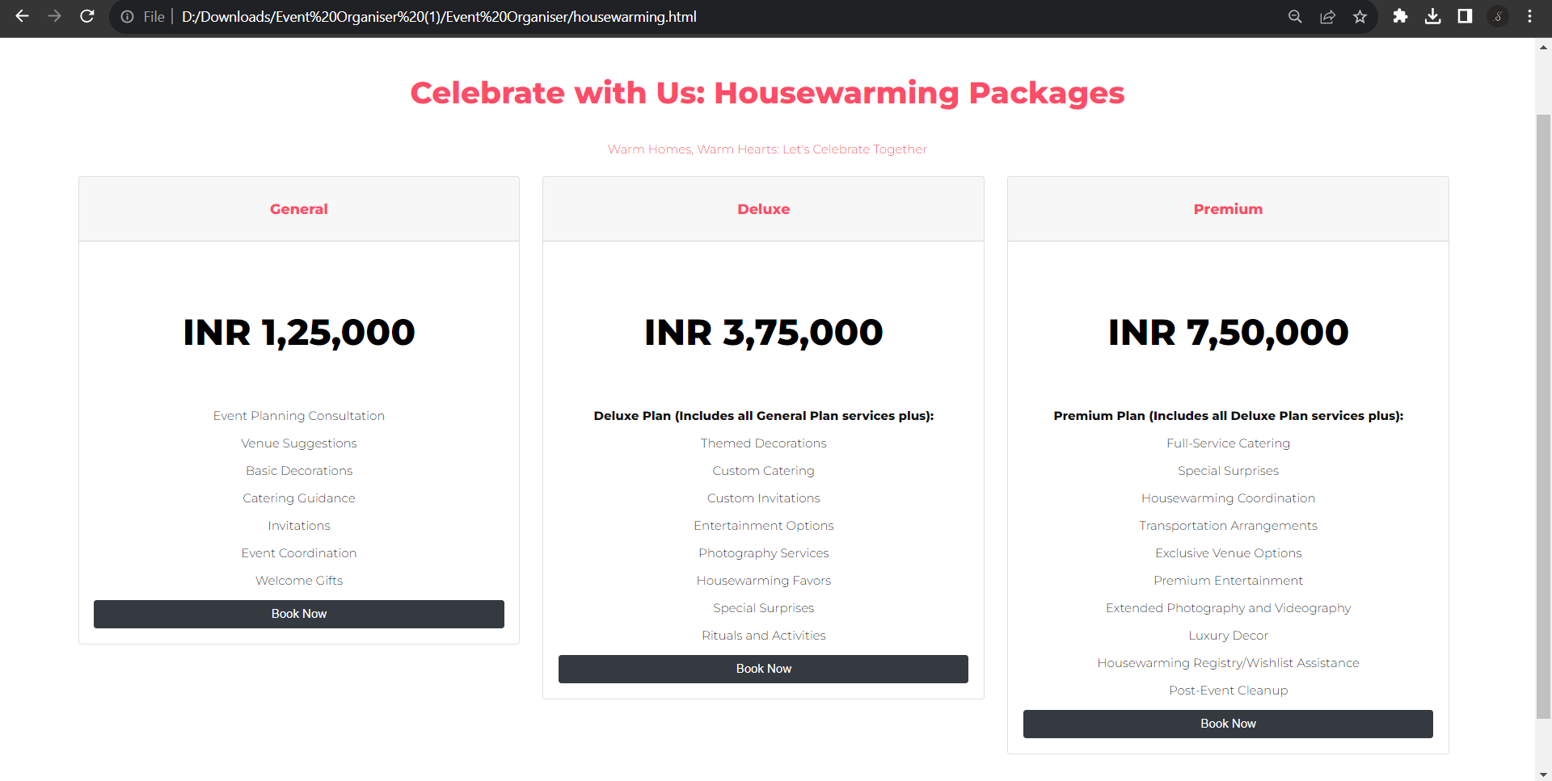
Quotation for House Warming ceremony

Slide 36
Clicking on 'User Registration' will redirect you to the user registration form page.

Slide 37
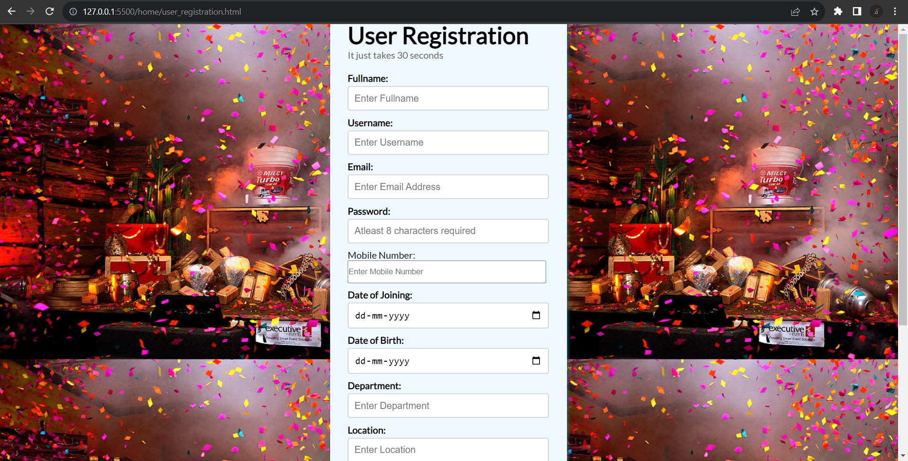
Clicking on 'User Registration' will redirect you to the user registration form page.

Slide 38
THANK YOU

